Slide 1
Model Calibration

Slide 2
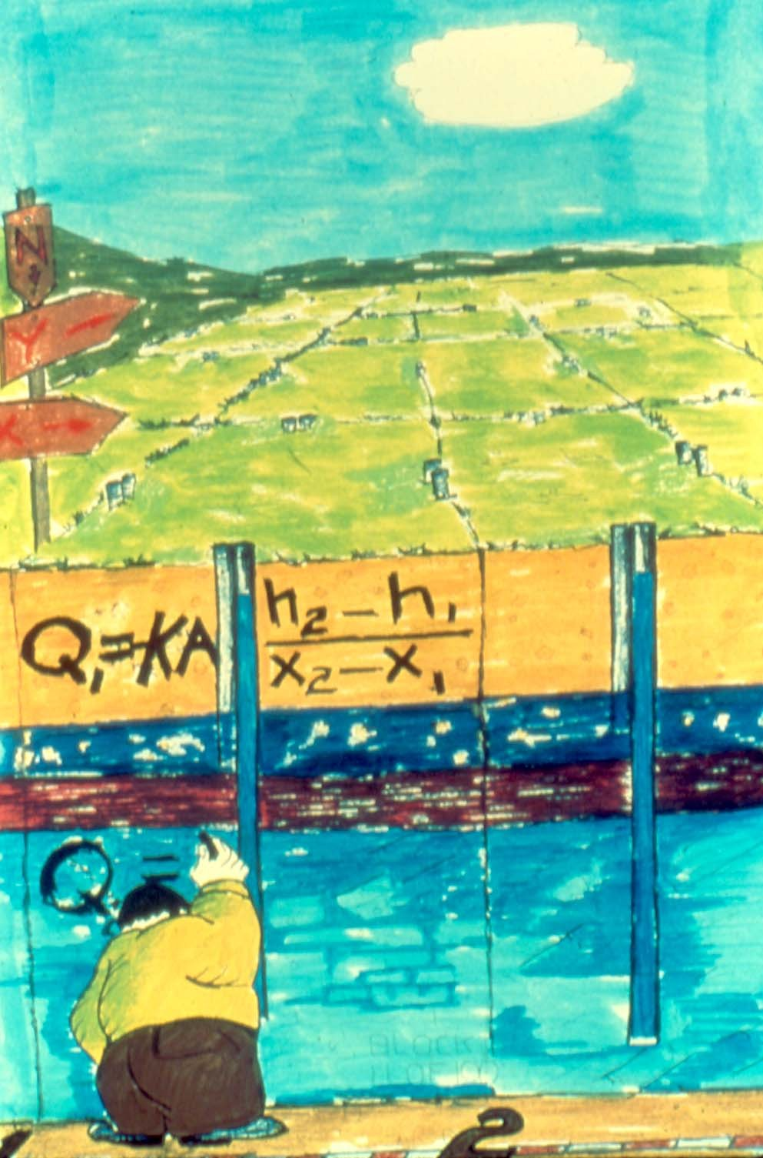
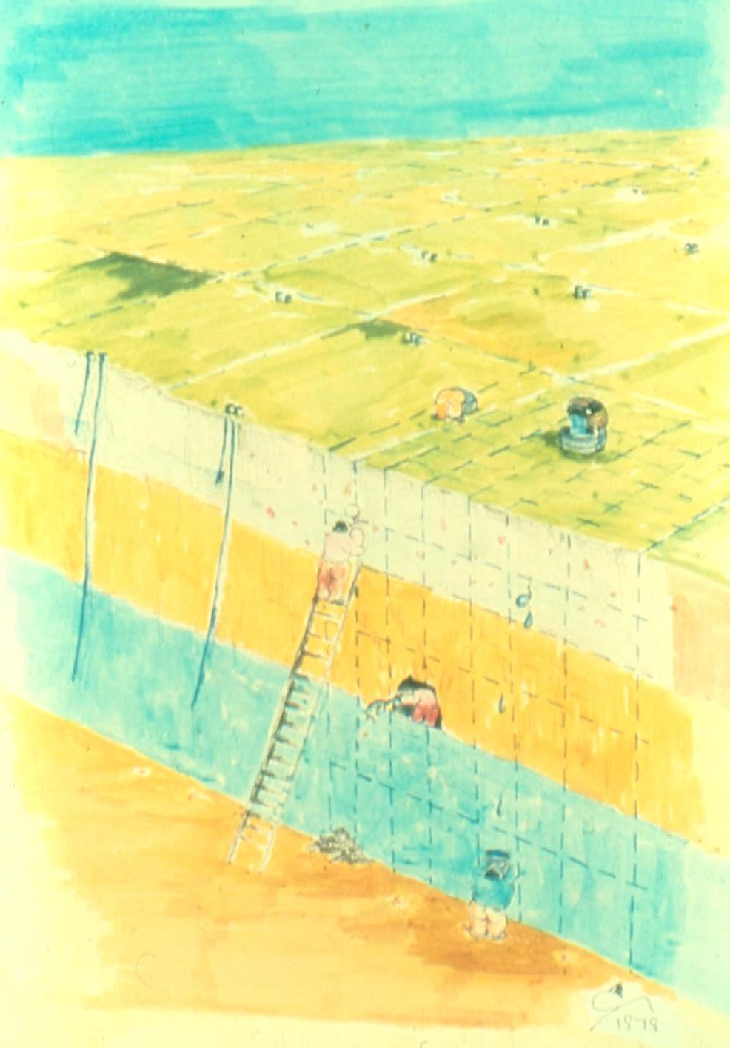
Model Calibration Process
By Bennett and Giusti
By Bennett and Giusti

Slide 3
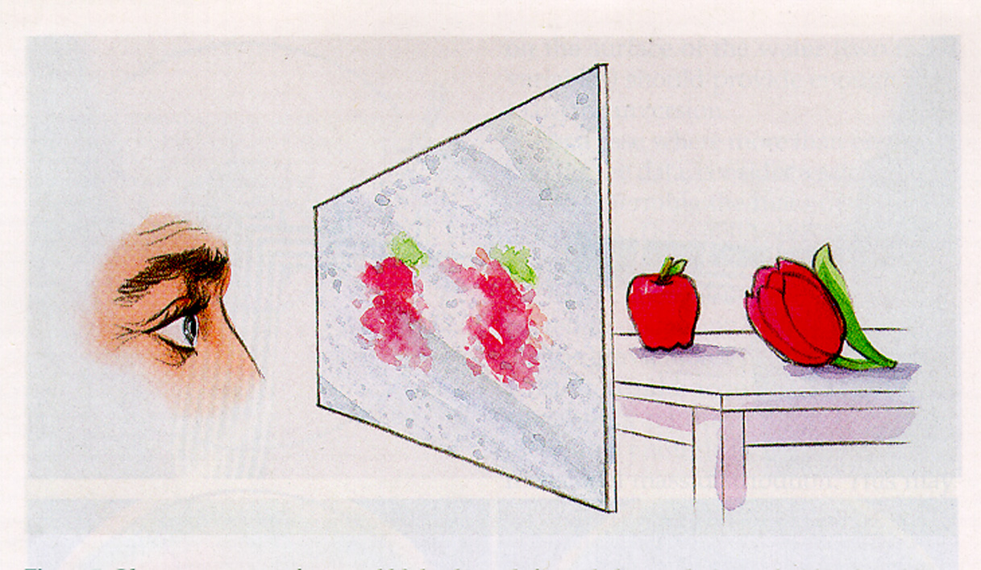
Estimating parameters is a nonunique inference process

Slide 4
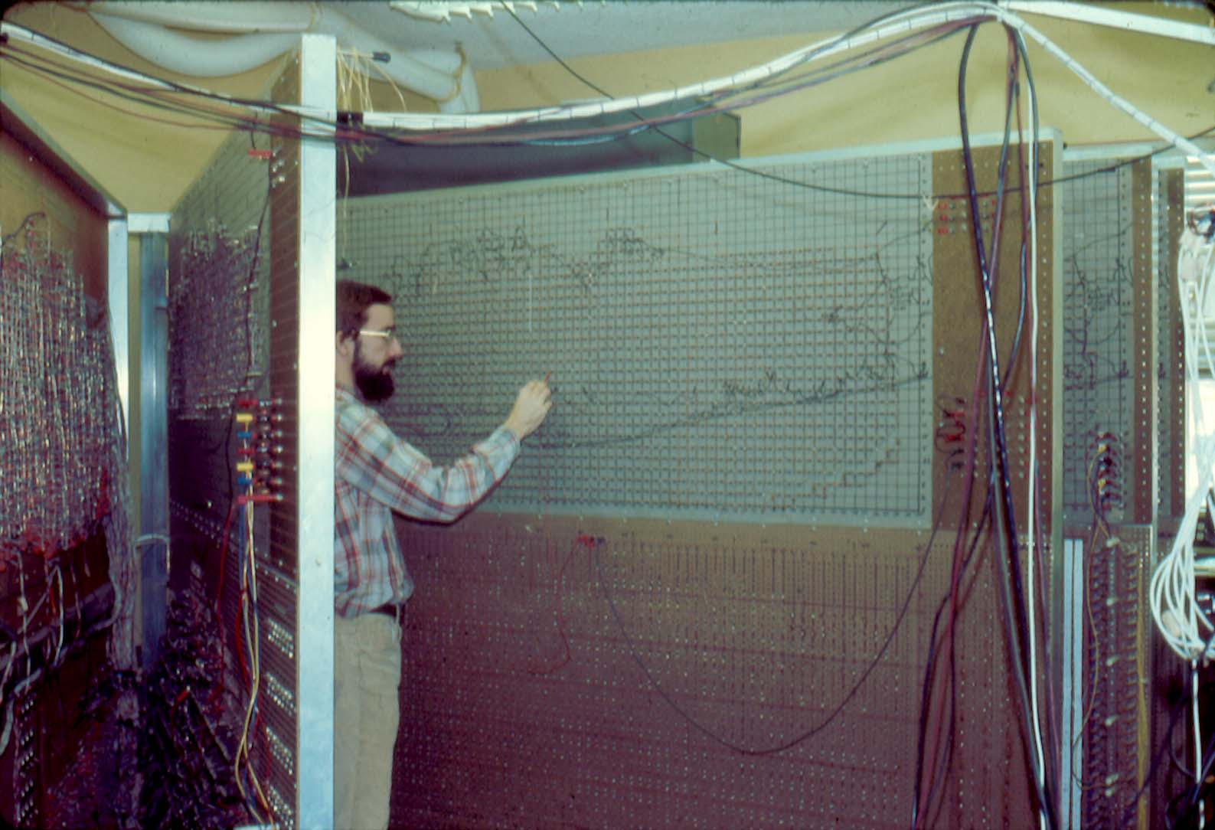
Early Model Calibration

Slide 5

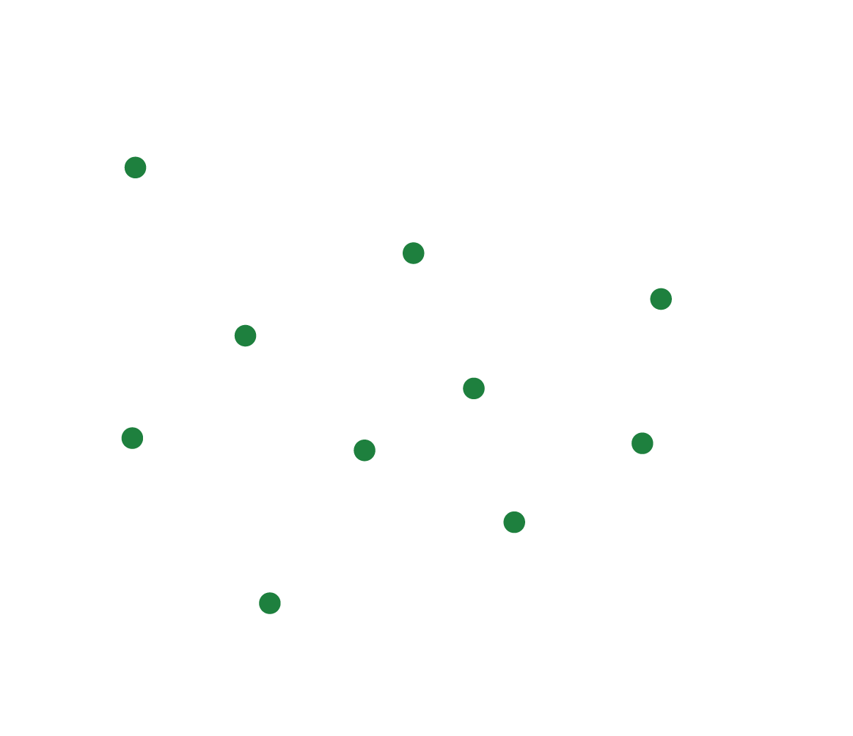
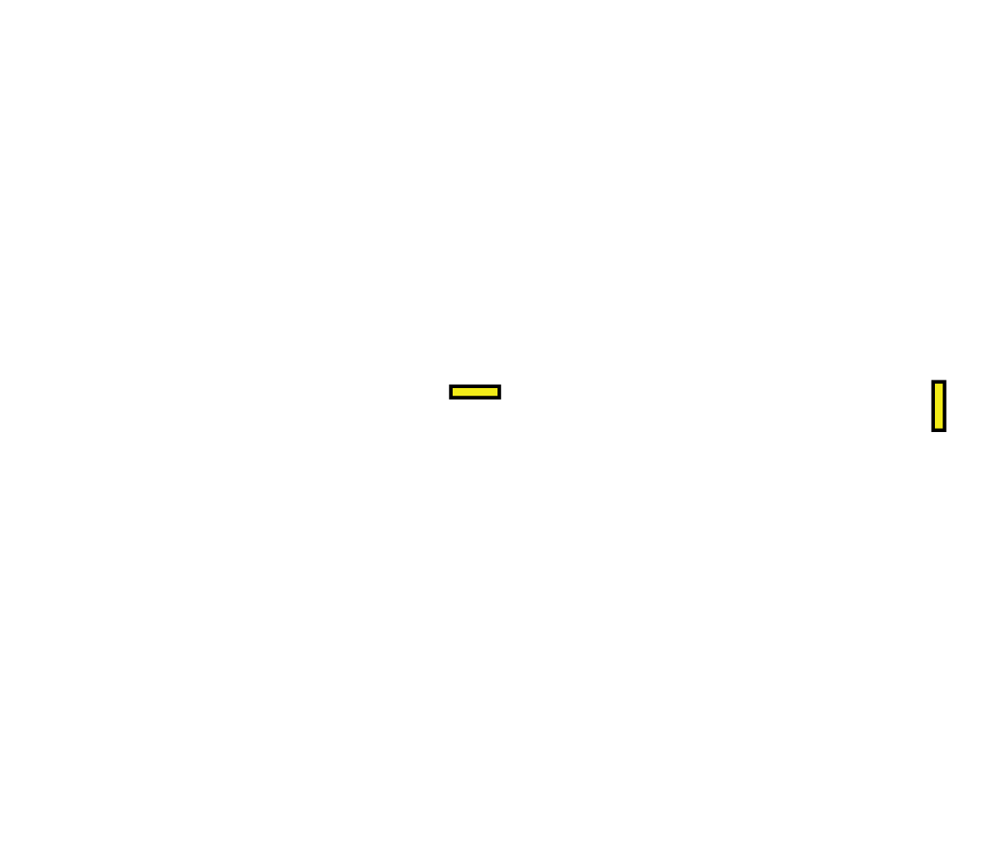
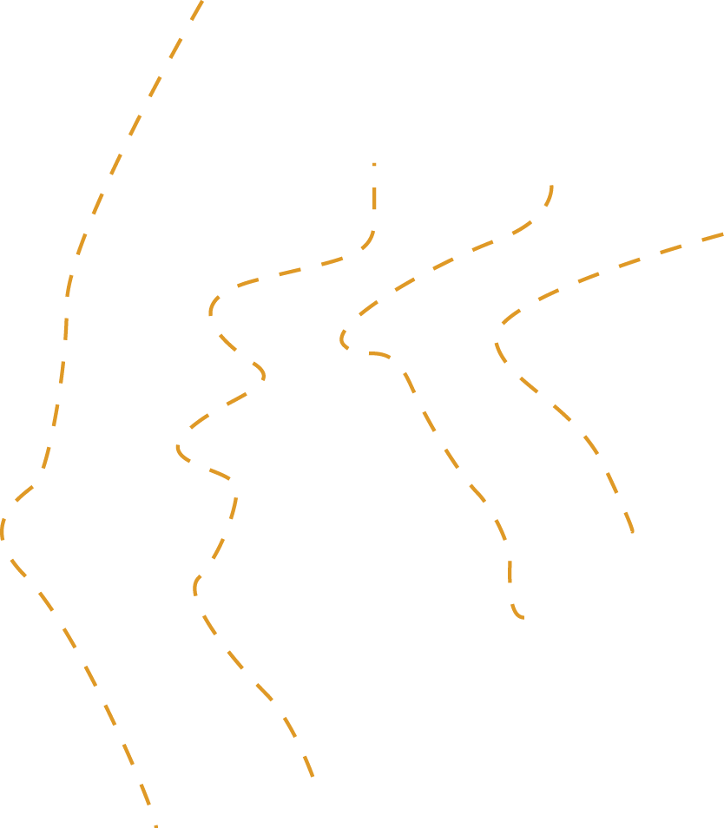


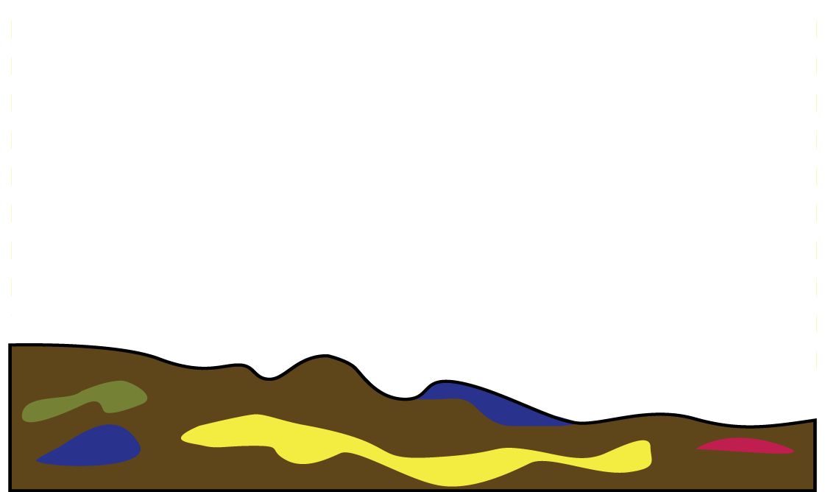
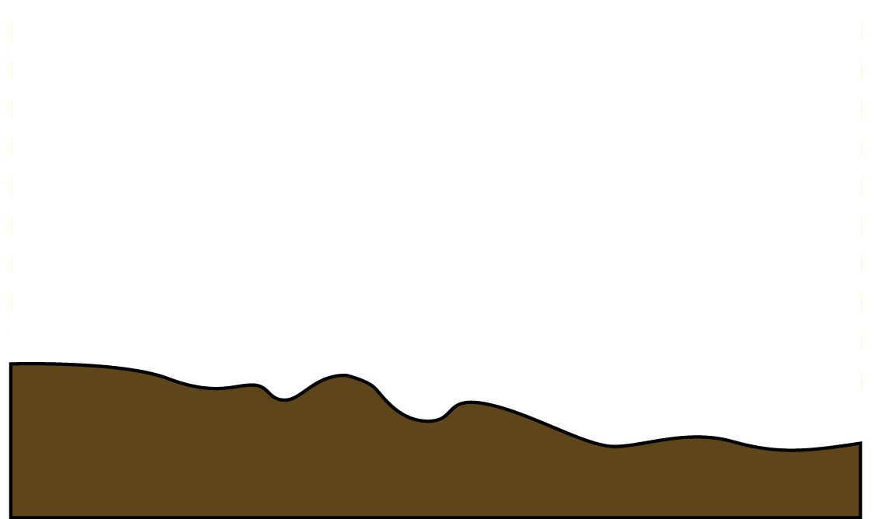

Calibration and Uncertainty
K
R
Notes:
5

Slide 6

Calibration and Uncertainty
More complex models → many parameters
Beyond Trial-and-Error → robust statistical techniques can help
Each parameter has some uncertainty associated with it
Predictions made using the model and these parameters will also have uncertainty to consider.
R
R
R
R
R
R

Slide 7
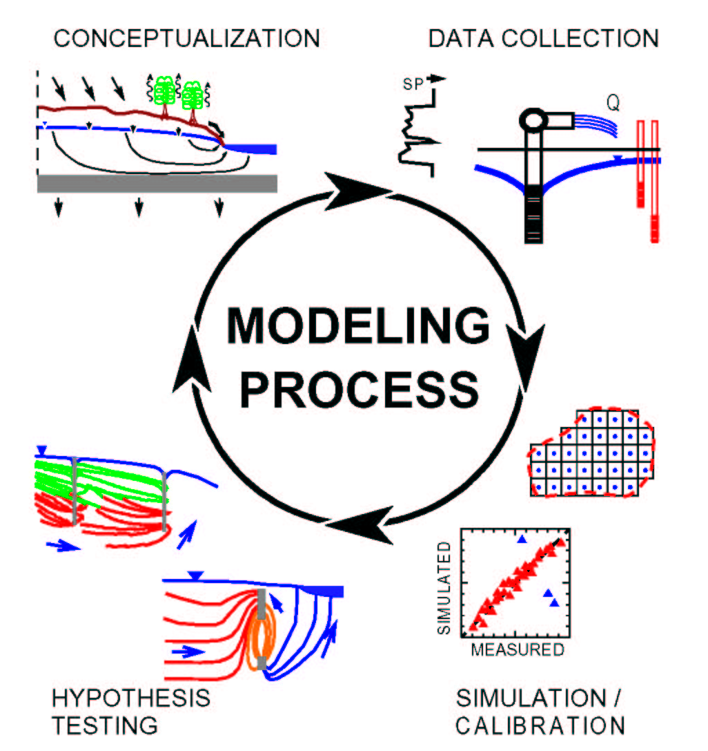
Model Calibration Concept
By K.J. Halford, 1991

Slide 8
Types of Observations
Heads and head differences
Flows and seepage runs
Groundwater age
Concentration
Temperature
Pathlines
Others

Slide 9
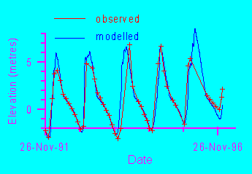
Residuals
Difference between a simulated value and its observed counterpart
For transient models, there may be many different measurements at the same location

Slide 10
Measures Of Goodness Of Fit
Weighted residuals (sum of squared errors)
Mean error (ME)
Mean absolute error (MAE)
Root mean squared (RMS) error
Nash-Sutcliff model efficiency (NS)
The distribution of residuals
Qualitative comparison of the observed and simulated contoured head surface

Slide 11
ME and MAE

Slide 12
RMS and NSE

Slide 13
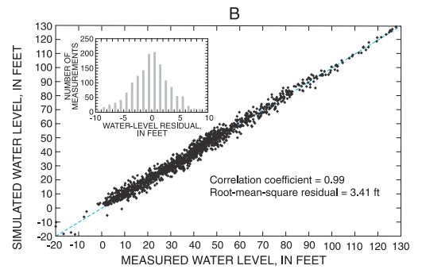
Residuals
-
+
-
+
-
+
+
-
Random distribution (good)
-
-
-
-
+
+
+
+
Non-random distribution (not good)

Slide 14
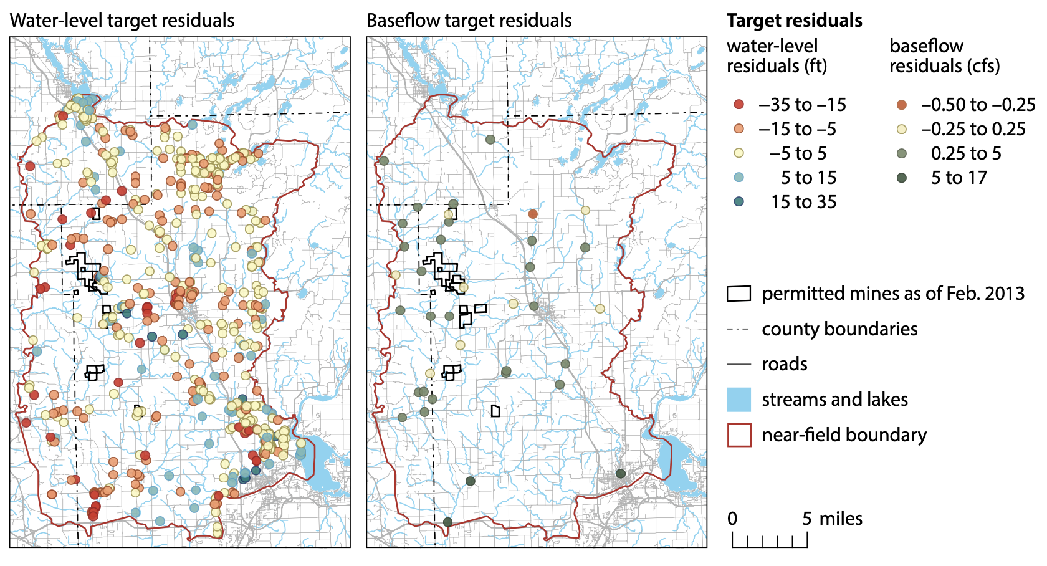
Residuals

Slide 15
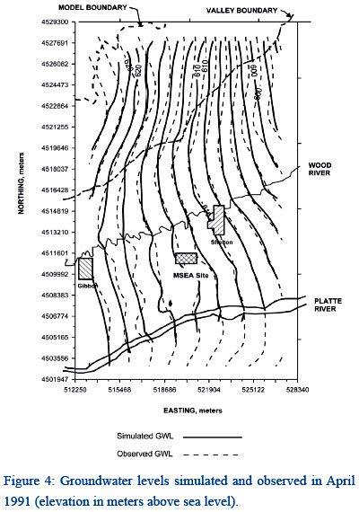
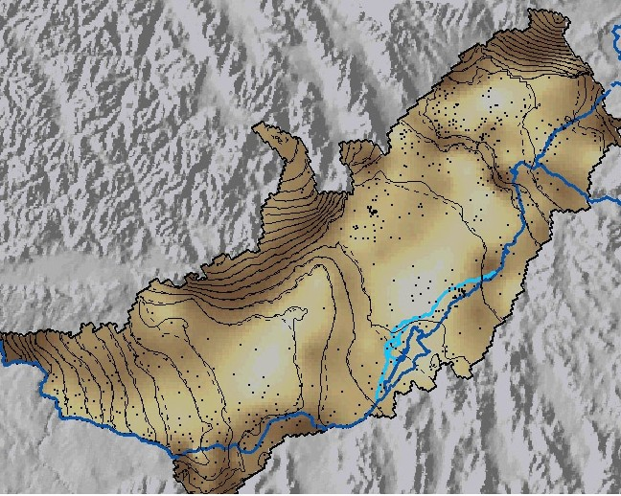
Qualitative Contour Comparison

Slide 16
Model Parameterization
Zones
Highly parameterized
Pilot Points
Geostatistical generating functions
Grid-based parameters

Slide 17
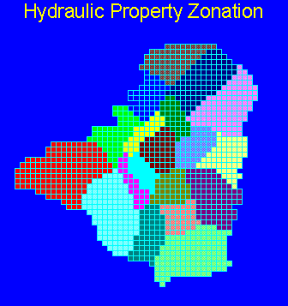
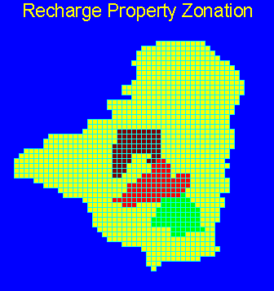
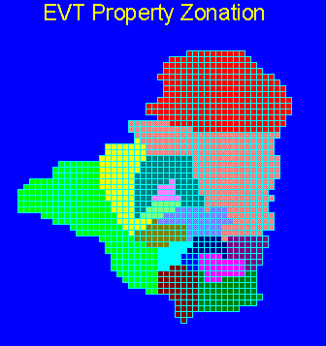
Zone Parameterization

Slide 18
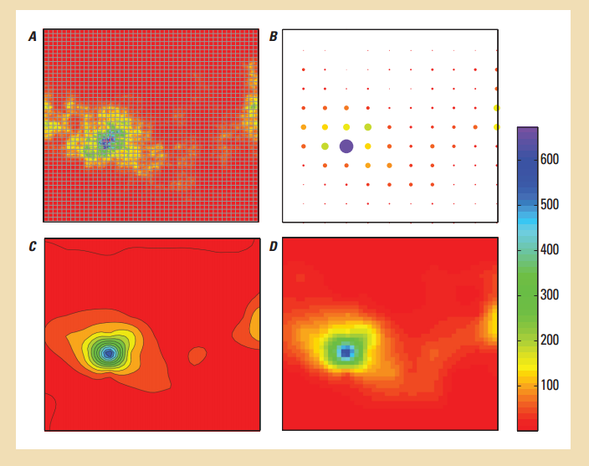
Pilot Point Parameterization

Slide 19
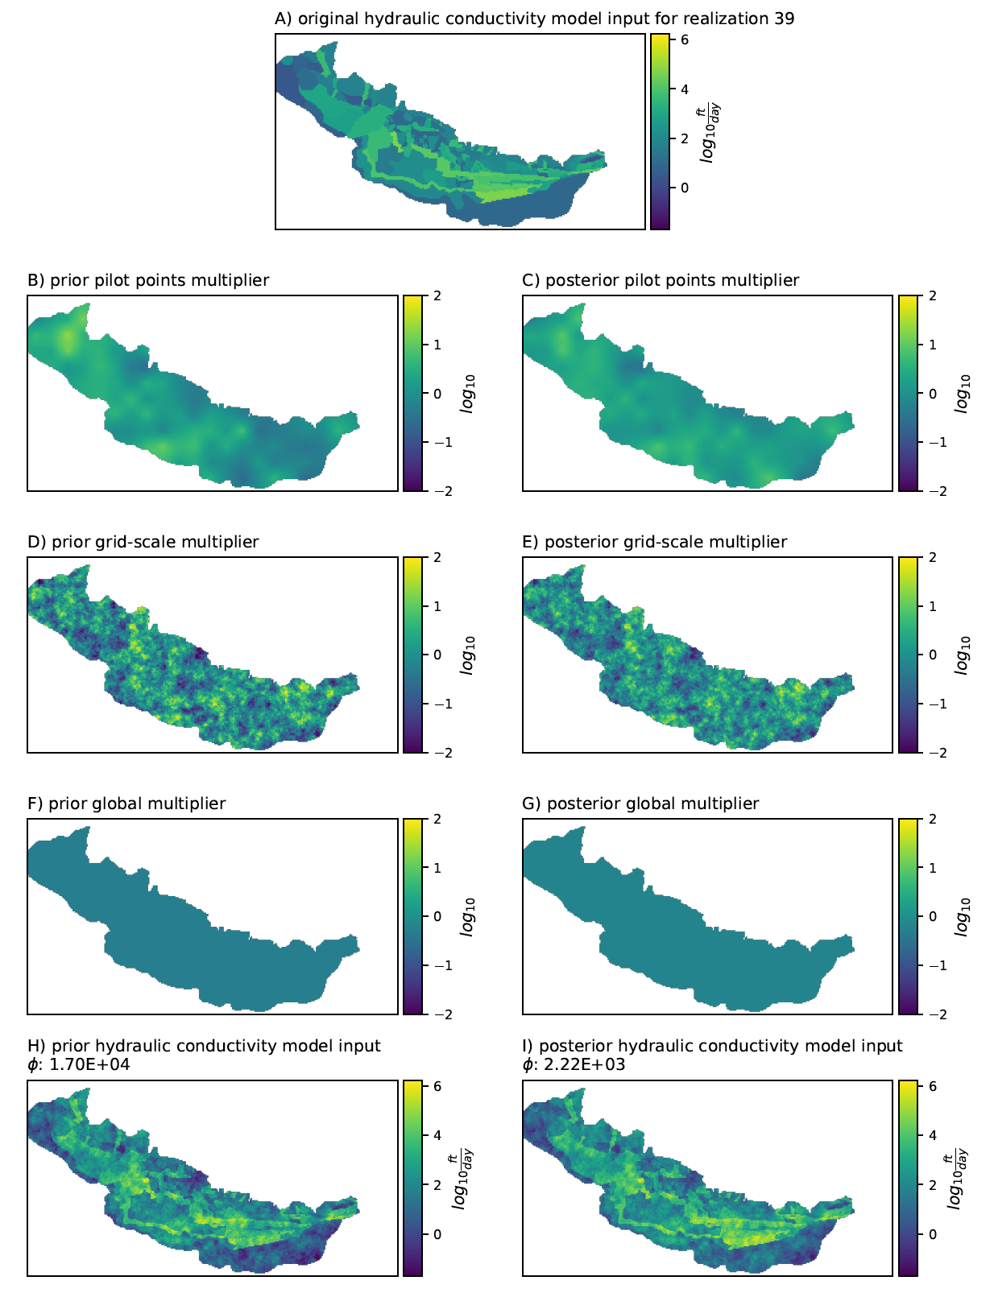
Multi-Scale Parameterization

Slide 20
Parameter Estimation Approaches
Trial and error
“Automated” parameter estimation
PEST++
PEST
A Bayesian approach merges these two

Slide 21
Trial and Error
Group like-type parameters into coarse zones
Manual adjustment of parameters within reasonable limits in order to improve match between observed and simulated values

Slide 22
“Automated” Parameter Estimation
Aka History Matching
Two different categories
Overdetermined: more observations than parameters
Underdetermined (highly parameterized): may have more parameters than observations. Requires additional information.
Neither are really automated!

Slide 23
Automated Parameter Estimation
The concept:
HEAD
HYDRAULIC CONDUCTIVITY

Slide 24
Automated Parameter Estimation
Application to many parameters and observations:
NOBS
NPAR

Slide 25
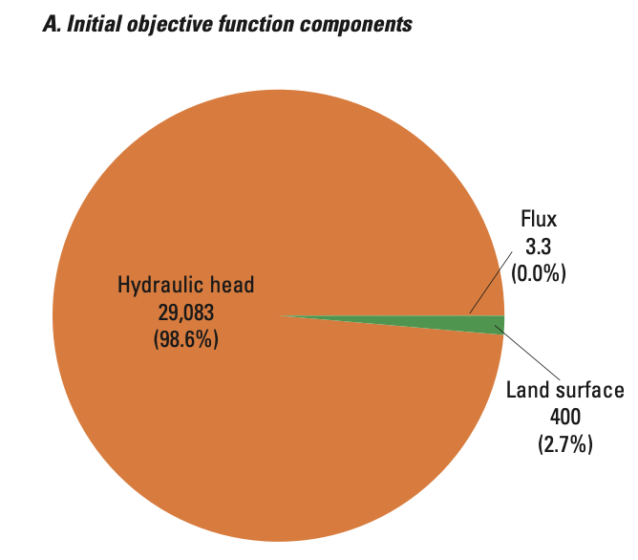
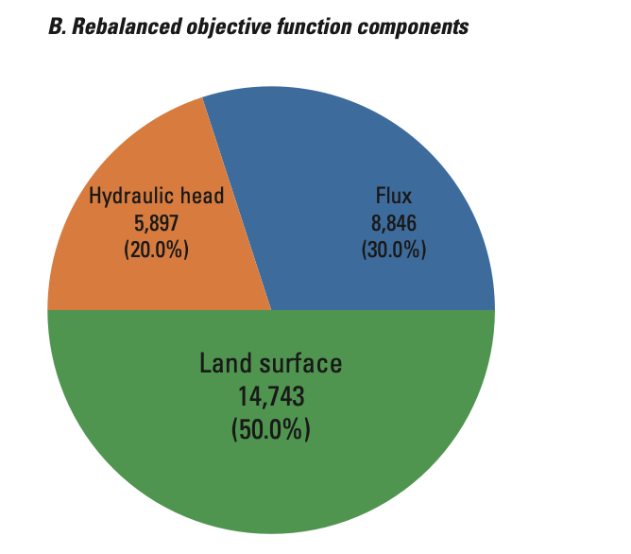
Automated Parameter Estimation
Sum of squared weighted residuals:

Slide 26
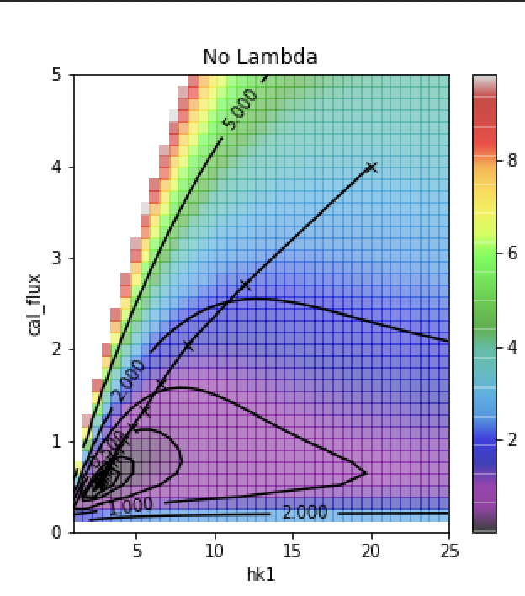
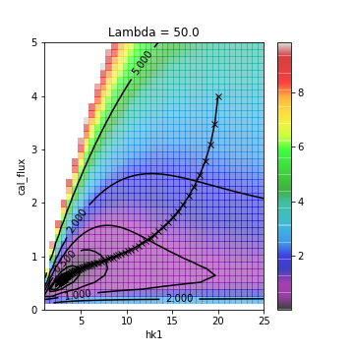
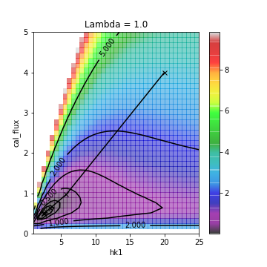
Automated Parameter Estimation
Non-linear parameter estimation (response surface and Marquardt Lambda):

Slide 27
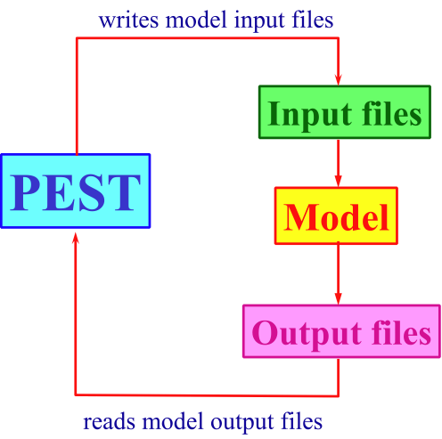
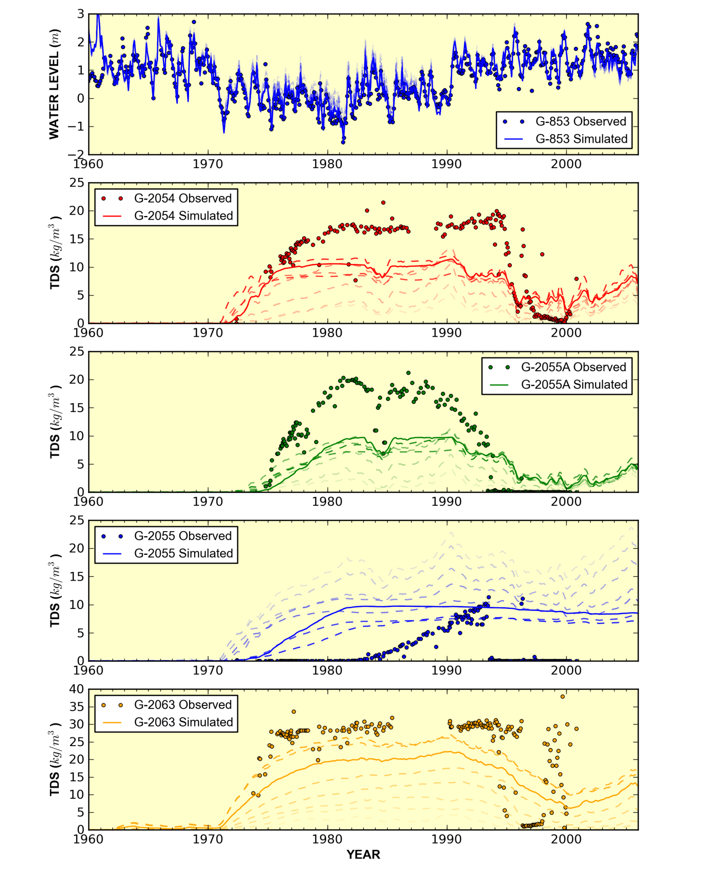
Automated Parameter Estimation
Execution procedure:

Slide 28
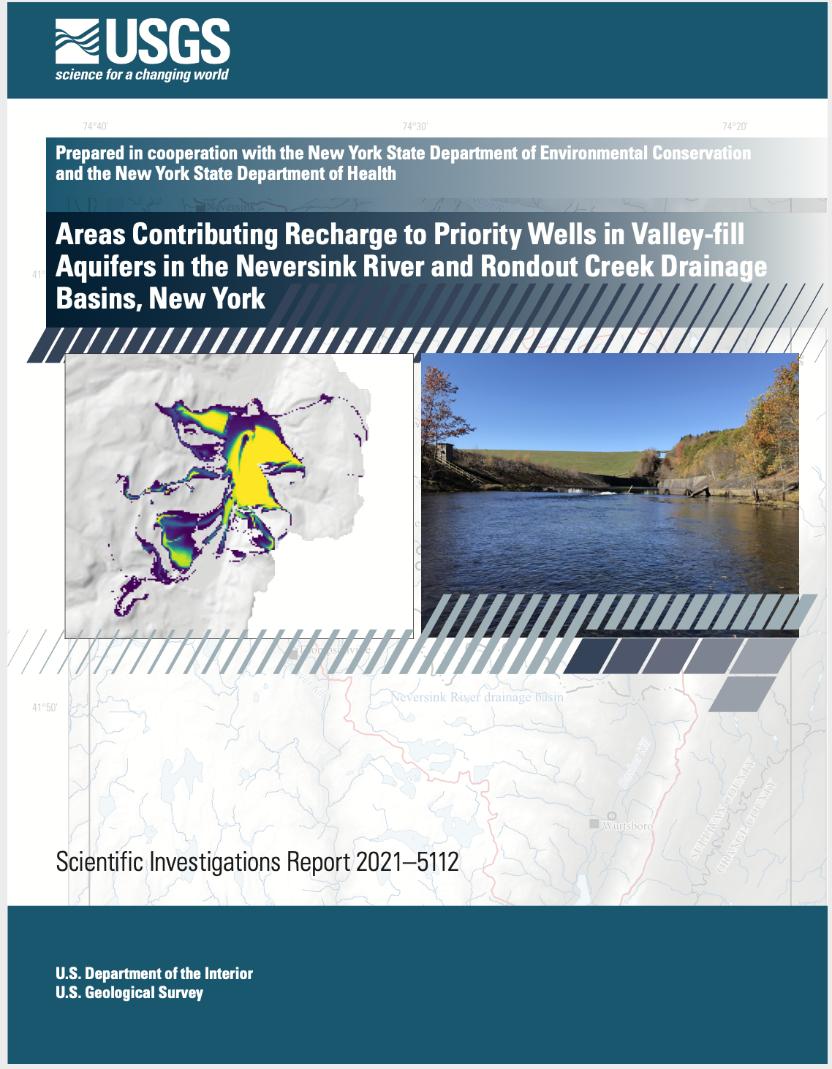
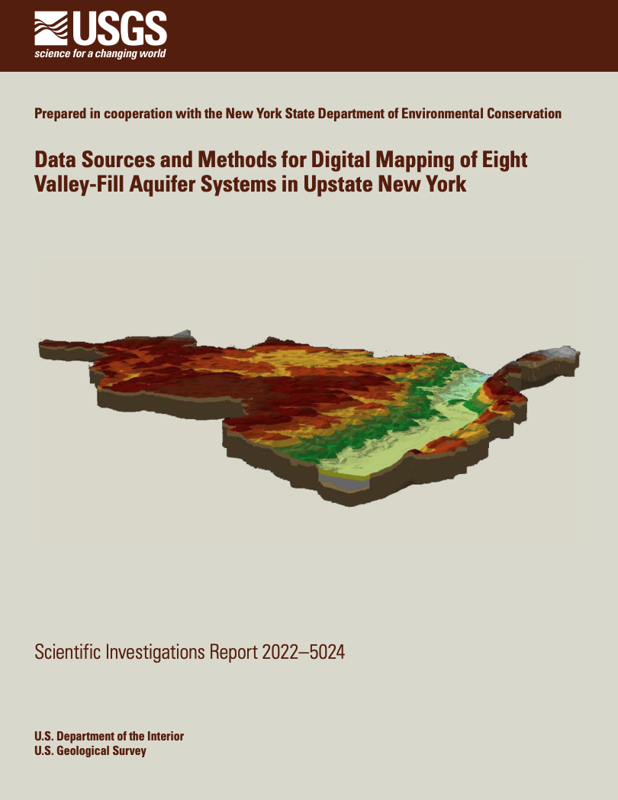
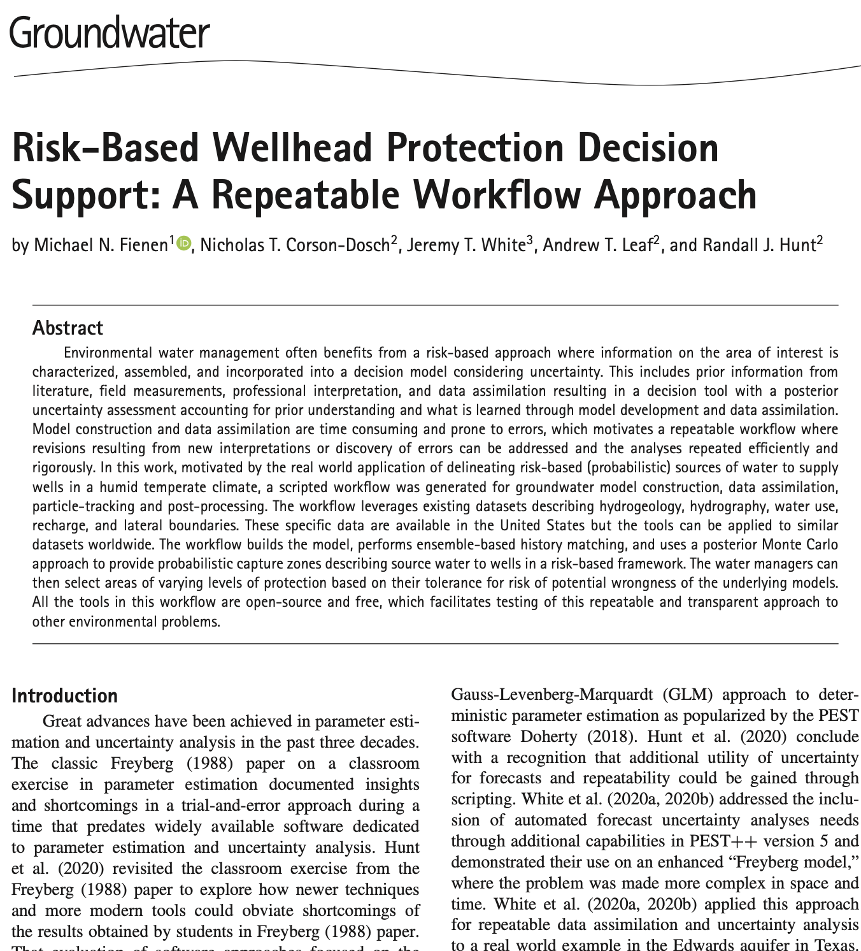
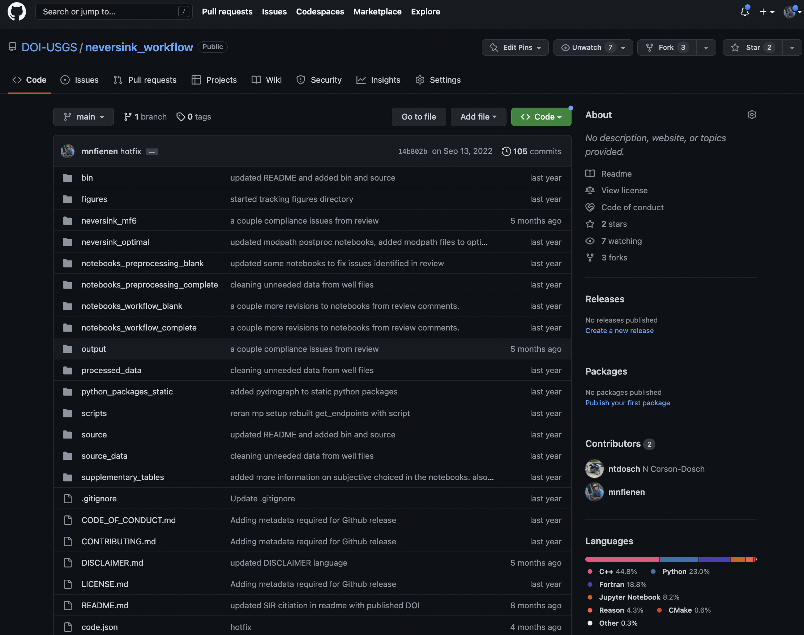
Parameter Estimation Examples
Probabilistic Capture Zones for the Rondout-Neversink basins in New York
https://doi.org/10.3133/
sir20215112
https://doi.org/10.3133/
sir20225024
https://doi.org/10.1111/
gwat.13129
https://github.com/DOI-usgs/
neversink_workflow

Slide 29
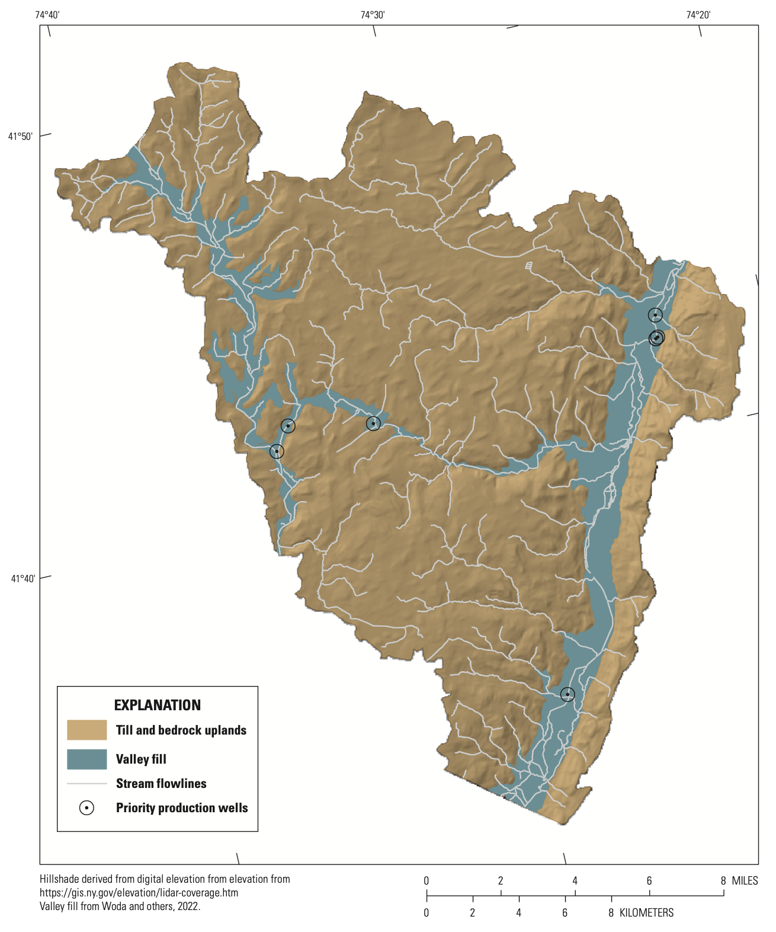
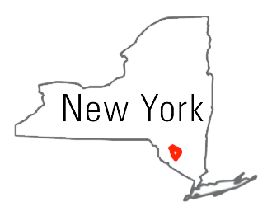
Parameter Estimation Examples
Risk-based decision-support system for wellhead protection in a glacial aquifer in the the Neversink-Rondout Basin, New York
Making a Bayesian update, incorporating observation information into a prior conceptualization

Slide 30
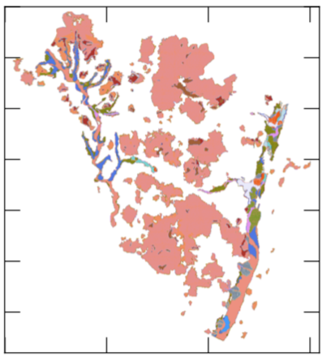
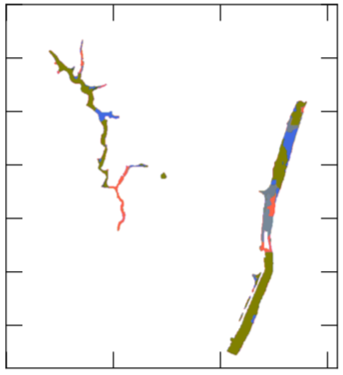
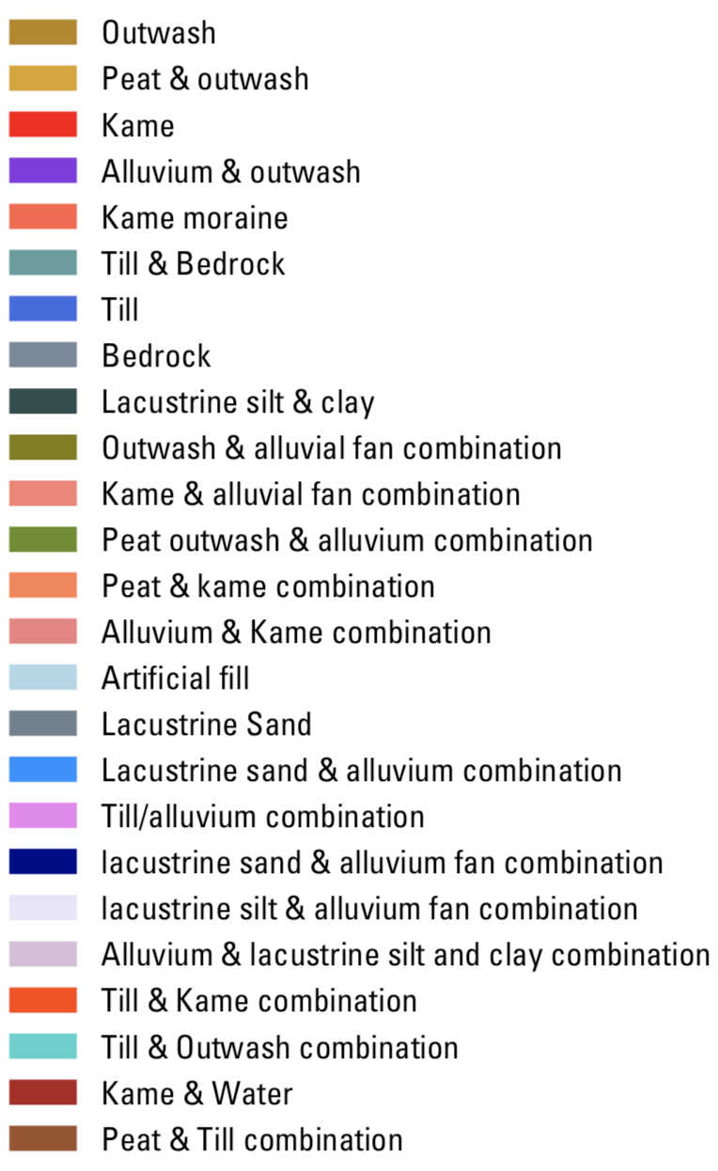
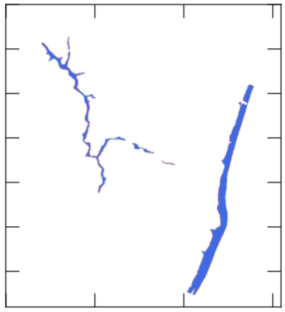
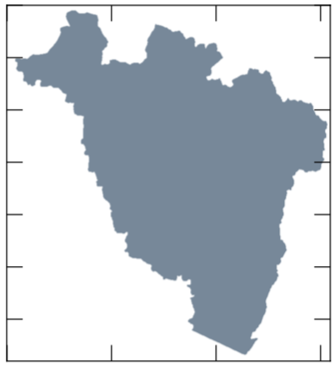
Model Calibration Examples
MODFLOW 6 ---
removing
inactive cells
Sped up execution 92% #wat?
Layer 1: All Lithologies
Layer 2: Glacial
Layer 3: Glacial
Layer 4: Bedrock

Slide 31
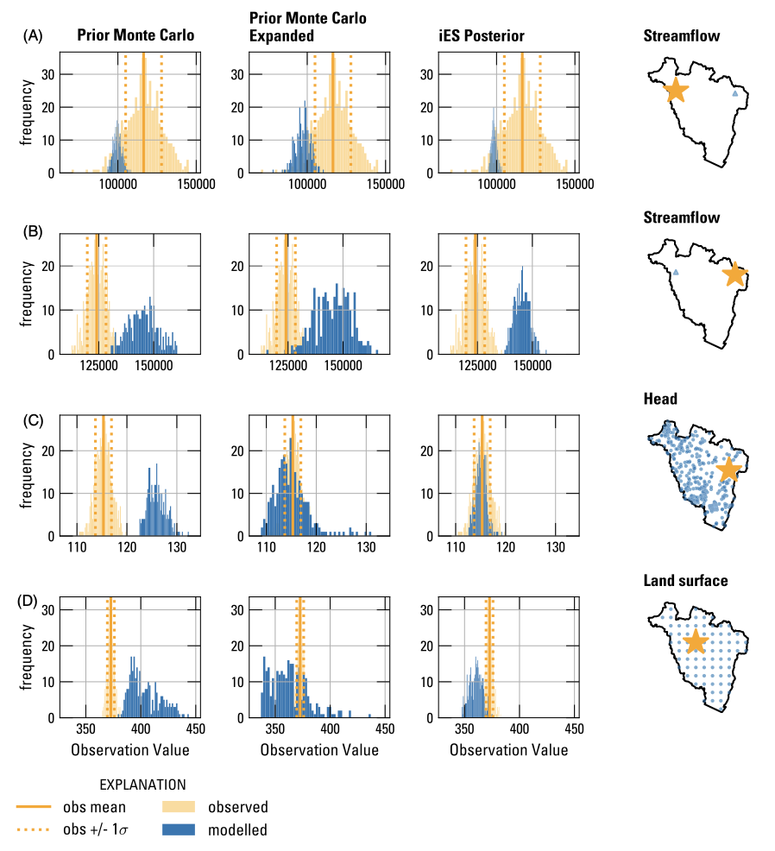
Model Calibration Examples

Slide 32
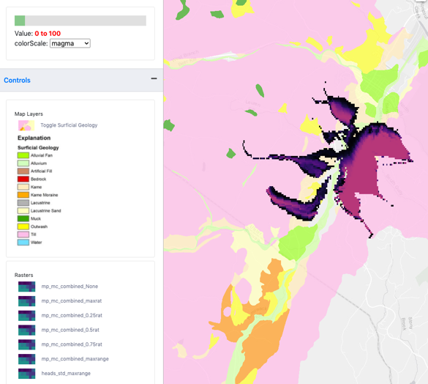
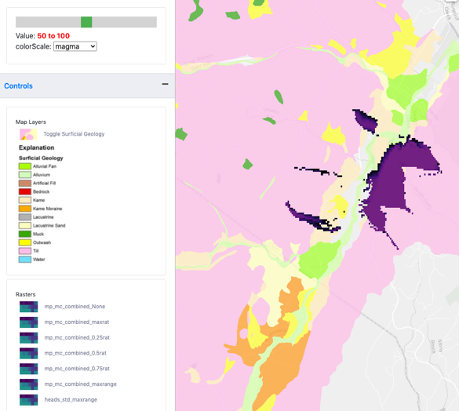
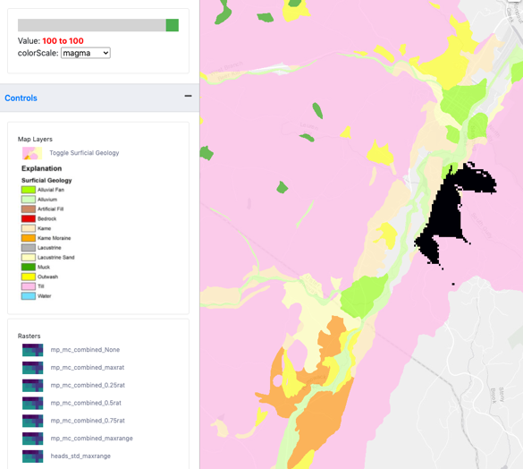
Risk-Based Decision Support Tool
Risk averse
Risk neutral
Risk tolerant

Slide 33
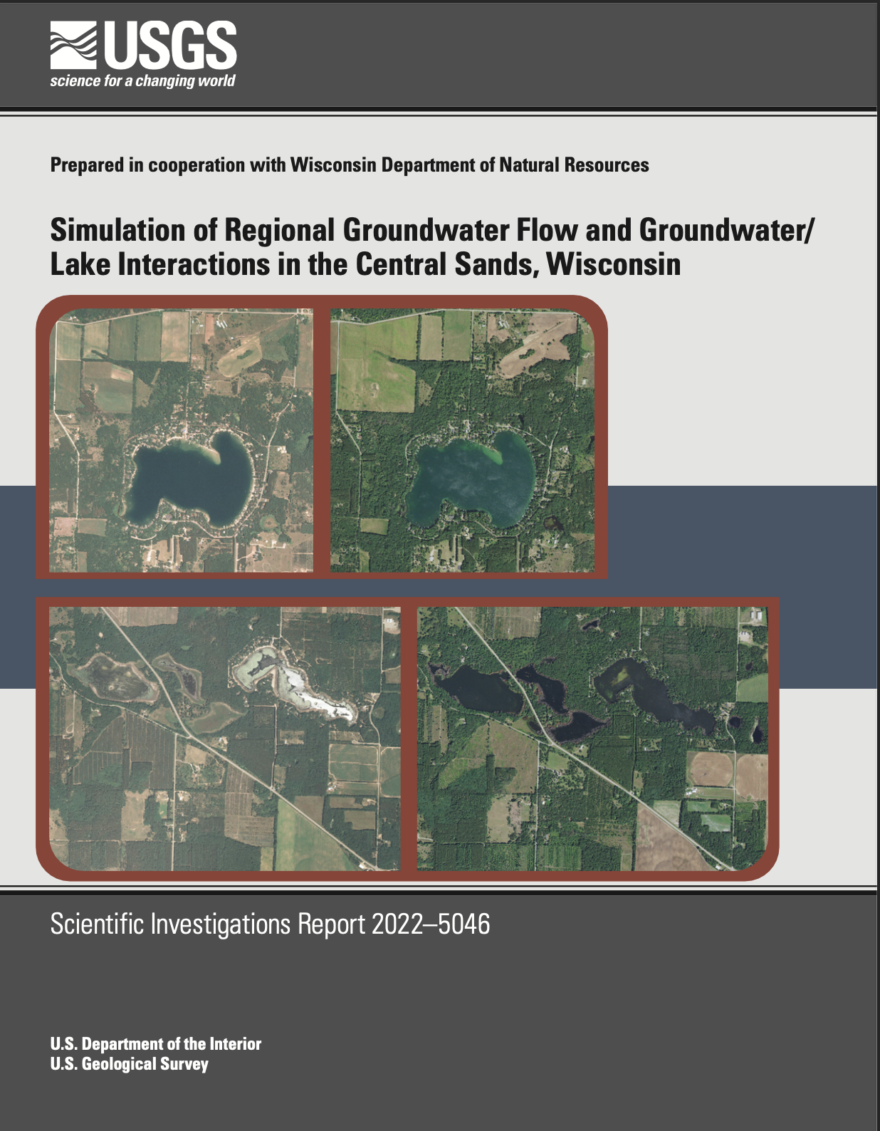
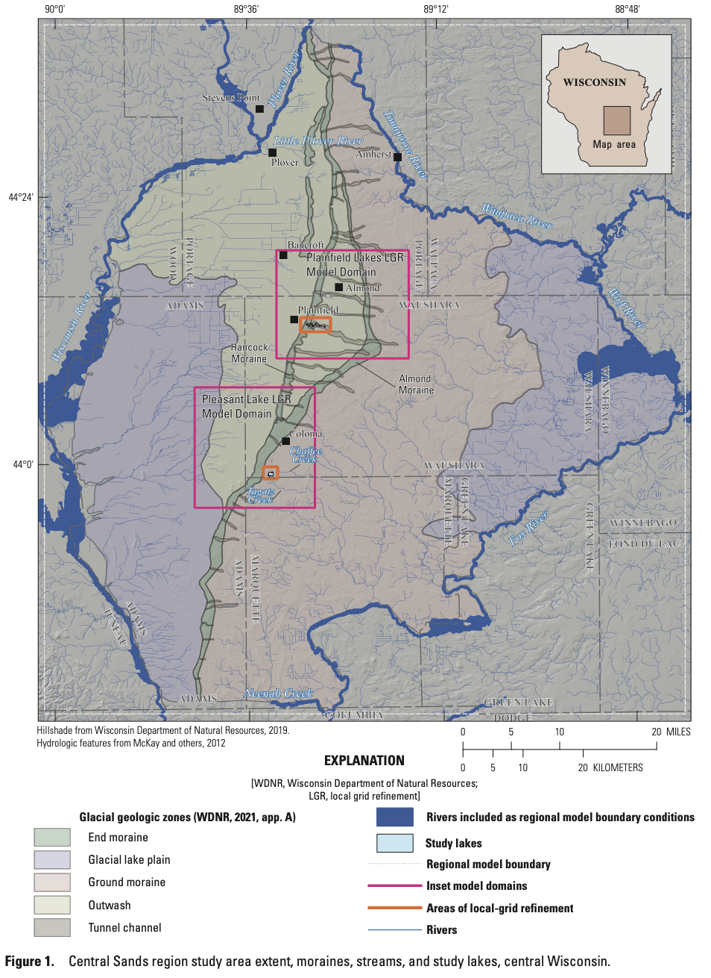
Model Calibration Examples

Slide 34
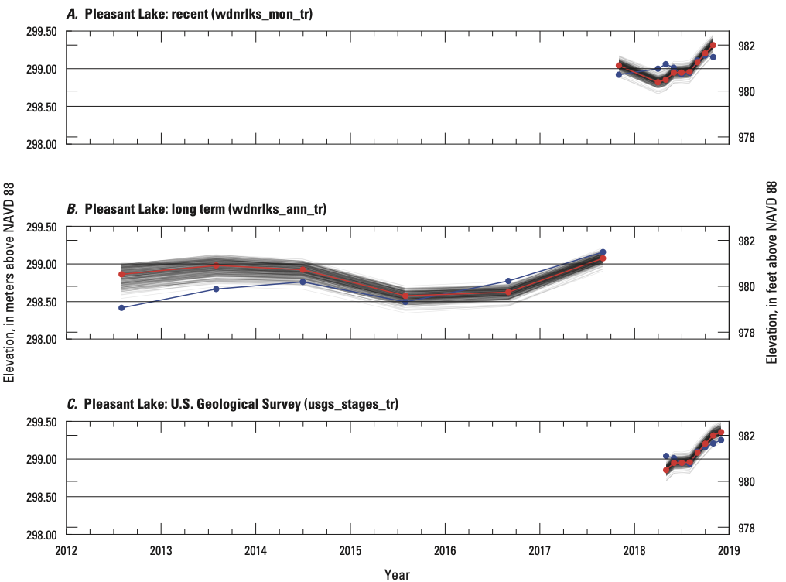
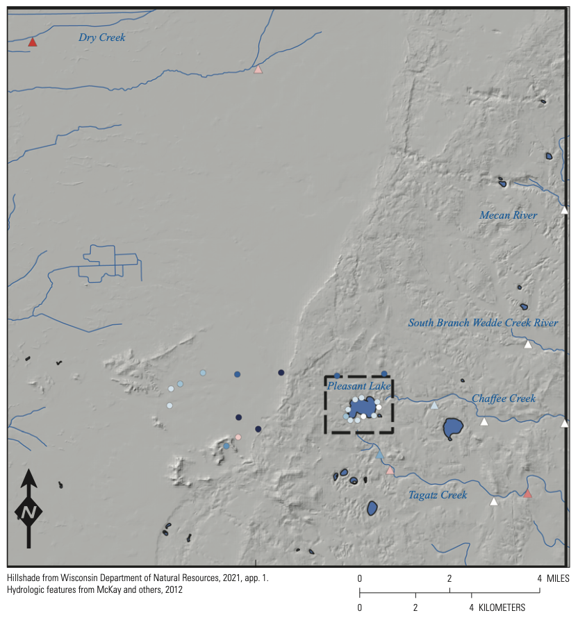
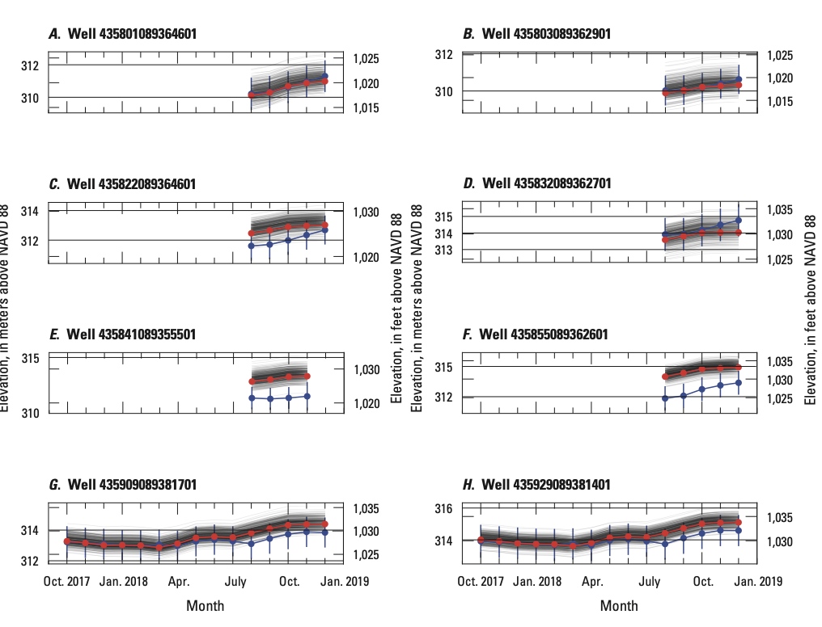
Model Calibration Examples – cont.

Slide 35
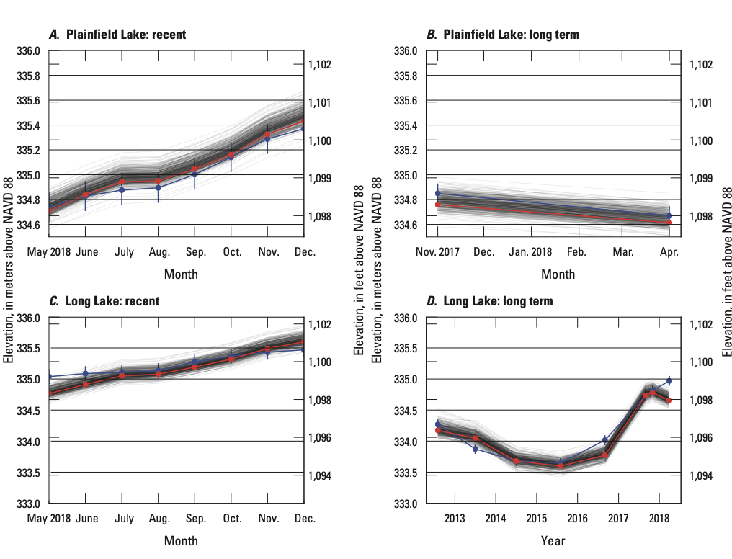
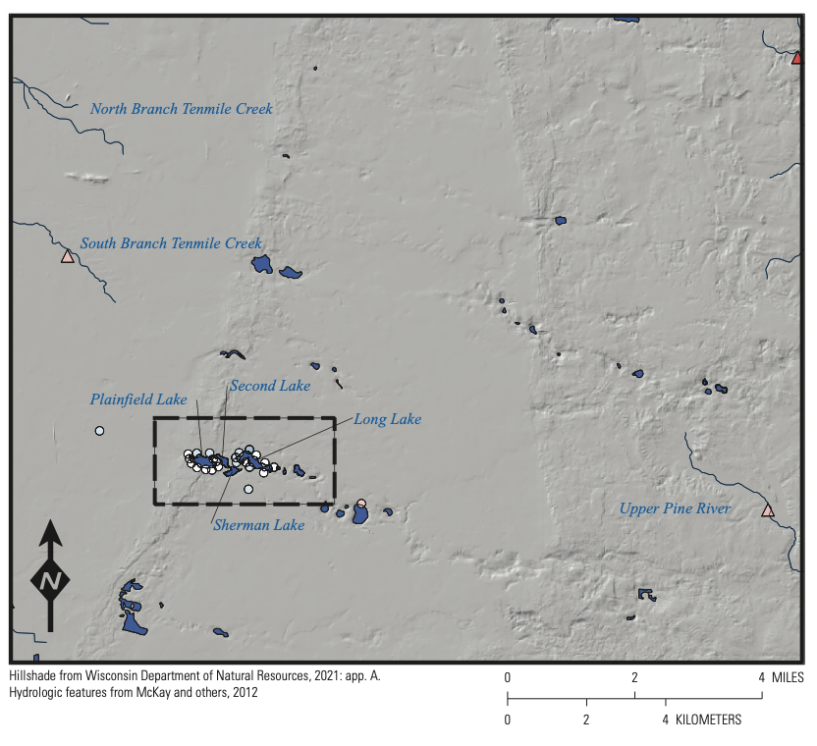
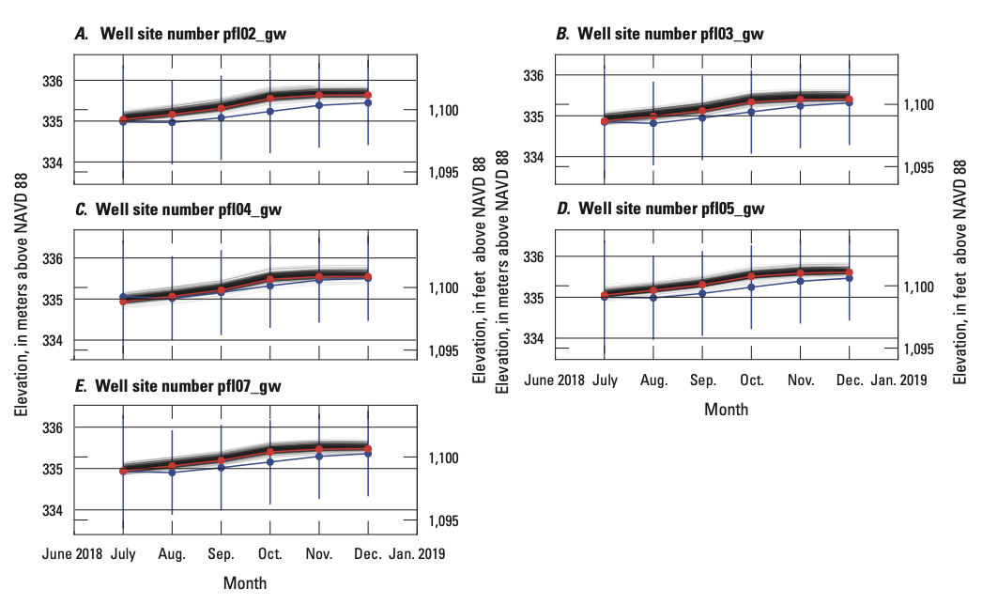
Model Calibration Examples – cont.

Slide 36

Model Calibration Examples – cont.

Slide 37
Concepts To Keep In Mind
Compare multiple observation types (for example, heads, flows, concentrations)
Continuously re-evaluate the system conceptualization – boundary conditions, framework, etc.
Try to understand the sensitivity of the system to different parameters and boundaries
We are trying to make a simplified mathematical copy of the real world

Slide 38
Calibration is but one part of our attempt to understand and duplicate the actual system in a numerical model.
WARNING:
“… a model involving a wrong or incomplete conceptual model can be adequately calibrated.”
Bradehoeft, J.D, 2003, From models to performance assessment: the conceptualization problem. Ground Water, v. 41, no. 5, 571-577, DOI: 10.1111/j.1745-6584.2003.tb02395.x.

Slide 39
USGS Modeling Report Components
A description of the natural system.
A description of the numerical counterpart with the model input fully documented.
A convincing argument that the numerical model is a plausible representation of the natural system.

Slide 40
Some resources
PEST and PEST++: http://pesthomepage.org
pyemu: https://github.com/pypest/pyemu
tutorial notebooks: https://github.com/gmdsi/GMDSI_notebooks
Complete worked examples:
Neversink https://github.com/DOI-USGS/neversink_workflow
https://doi.org/10.3133/sir20215112
https://ngwa.onlinelibrary.wiley.com/doi/abs/10.1111/gwat.13129
Edwards aquifer: https://doi.org/10.5066/P9AUZMI7

